Slide 1
Chapter 2: Patterns, principles, and security models
Prof. E.B. Fernandez

Slide 2
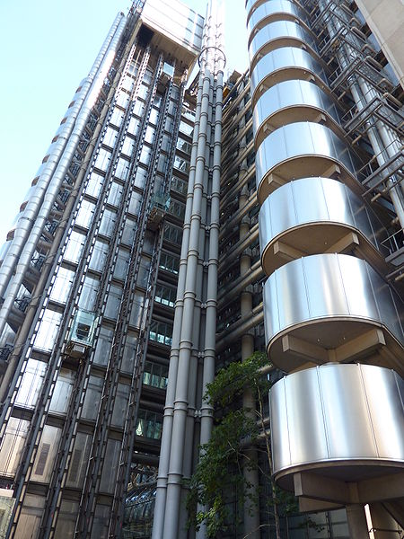
Patterns
A pattern is a solution to a recurring problem in a specific context
The idea comes from building architecture (Christopher Alexander)
It was applied initially to software but it has been extended to other aspects.
It appeared in 1994 and it is slowly being accepted by industry.

Slide 3
Value of patterns
A pattern addresses a recurring design problem that appears in some design step and provides a solution for it. It encapsulates the experience and knowledge of designers (best practices)
Patterns can be used to document design experience and record design decisions.
Patterns are sets of classes, above the abstractions presented by classes or objects, so they provide a larger unit of reuse.

Slide 4
Patterns II
Patterns provide a communication vocabulary for designers.
Patterns can be used as guidelines for new designs. The designer can know in this way which parts of a new system or product are fundamental and which ones can be added later.
Patterns can be used to evaluate existing designs. We can see if a product we are considering has features we consider important. Note that the existing system does not need to have been built using patterns.

Slide 5
Patterns III
Patterns can make complex standards easier to understand, implement, and use. Some standards are very complex and are described using low-level details; a good model makes them much clearer.
We can simulate specific systems by instantiating patterns to describe the system that we are considering. We can then perform a simulation and study aspects such as scalability, number of required messages between nodes, etc.
The UML classes in the pattern solution can be converted by the code generation part of a tool such as Rational Rose into C++ or Java or any other language. UML models are language independent. A good modeler can build better code and handle bigger systems that pure coders.

Slide 6
Why security patterns?
Analysis patterns can be used to build conceptual models of software, design patterns can be used to make software more flexible and reusable, and security patterns can be used to build secure systems, including software and hardware.
Security has had a long trajectory, starting from the early models of Lampson and Bell/LaPadula in the early 70s, and resulting in a variety of approaches to analyze security problems and to design security mechanisms. It is natural to try to codify this expertise in the form of patterns.
Security patterns describe mechanisms to stop or mitigate attacks, correct a vulnerability, and apply principles of good design

Slide 7
Value of security patterns
Can guide the use of security mechanisms in an application (stop specific threats)
Can apply security principles directly (Least privilege) or describe security mechanisms able to stop specific threats or that can correct a vulnerability
Can guide the design and implementation of the security mechanism itself, e.g. a firewall
Can help understanding and using complex standards (XACML, WS-Policy)
Convenient for teaching security principles and mechanisms

Slide 8
Security Patterns
Software Architecture
Security
Software
Engineering

Slide 9
Pattern mining
How do we find patterns?
Consider problems that appear in different systems, e.g. authentication
Look for analogies in systems. If two or more systems have similar ways of solving a problem you have a pattern
Search for commonalities in standards and regulations, e.g. HIPAA, Sarbanes-Oxley, FEMA, Web services security standards
From your own practice, remember similar solutions in other problems you have encountered

Slide 10
Pattern description: Templates
A template describes a pattern using a collection of sections that make explicit the function and use of the pattern
There are three commonly-used templates:
Gang of Four (GOF):
E. Gamma, R. Helm, R. Johnson, J. Vlissides
Principles of Software Architecture (POSA):
Buschmann et al.
C. Alexander (an architect of buildings)

Slide 11
POSA template
Intent (thumbnail)
Example
Context
Problem and forces
Solution: in words, UML models (static and dynamic)
Implementation
Example resolved
Known uses
Consequences
See also (related patterns)

Slide 12
Using the patterns
Catalogs of patterns are not enough, designers must be given guidance in their use
There are many patterns (growing in number) and the task of selecting them gets harder
A first approach is to classify the patterns according to some criteria, e.g., architectural levels where they are used

Slide 13
Sec Pattern classification
Use a multidimensional matrix
Dimensions may include: architectural level, lifecycle stage, concern, type of pattern, domain,…
Example: XACML

Slide 15
Security layers

Slide 16
Trip to Hamburg, Germany
13th International Conference on Availability, Reliability and Security (ARES 2018), Hamburg, Germany, Aug. 27-30
E.B.Fernandez, N. Yoshioka, H. Washizaki, “Evaluating the degree of security of a system built using security patterns”
M. H. Syed and E.B.Fernandez, “A reference architecture for the container ecosystem
Four or five parallel sessions each day.
Interesting papers on threat intelligence, blockchain security, 5GPP security, privacy, CPS security,…

Slide 17
Threat/Misuse patterns
Describe threats and misuses from the point of view of the attacker.
They use sequence diagrams (and more details) to describe how an attacker performs a misuse, they describe attack scenarios
The pattern tries to show how the attacker works (modus operandi) so we can apply defenses to stop it
The objects in the sequence diagram represent architectural units of the target system that can be searched to collect evidence (forensics)

Slide 18
1..
1..
Application
*
UseCase
*
Activity
Threat
Pattern
encapsulates
*
targets
*
1
Threat
Asset
1
1
*
*
1
*
1
realizes
realizes
1
1
*
1
1
Attack
exploits
Vulnerability
Attack
Pattern
1..
*
*
*
encapsulates
realizes
*
neutralizes
1
Misuse
Pattern
*
SSF
*
*
SC
1
Security
Pattern (SP)
1..
*
SP Family
1..
*
0..1
Compound SP
Simple SP
ASP

Slide 19
Principles to build secure systems
To design secure systems we should apply good principles
Several principles have been extracted from experience
The first set came from a 1975 paper [Sal75].
Other principles have been added later [Sha02]
Applying principles requires experience and knowledge
If we build systems using patterns we can apply those principles implicitly, i.e. they help inexperienced designers

Slide 20
Security principles for system design
Closed system. Anything not explicitly allowed is forbidden. Here the policy is applied to application rights and to process resource access during execution.
Open design. When the mechanism is subject to public scrutiny it is easier to find flaws and with time it becomes increasingly secure. Some of the data used in the security system could be secret though, e.g., passwords, keys.
Least privilege. This is the application of a basic security policy at all design levels.
Economy of mechanism. The security mechanisms should be as simple and small as possible. This makes comprehension, testing, and analysis easier.

Slide 21
Security principles II
Complete mediation. Every request for access must be validated.
Minimal trust. The parts of the system that must be trusted should be minimal.
Separation of privilege. Critical actions may need two independent mechanisms to agree before being performed.
Least common mechanism. Minimize the amount of mechanism common to more than one user and depended on by all users.
Ease of use or transparency. Users must accept the security system or they will not use it. Security functions must be transparent or at least easy to use.
Information hiding and encapsulation. Implementation details should not be exposed, only a clear, functional interface should be shown. This principle comes from [Neu86] and points toward object-oriented design.

Slide 22
Security principles III (I found these in several places)
Holistic approach--Cover all architectural levels and all units, apply security in all phases of system design
Highest level—security constraints must be defined where their semantics are clear and propagated down
Defense in depth—have more than one line of defense
Separate and compartmentalize –isolate units that do related work at execution time
Safe defaults—failures (crashes) should close everything for access, everything not explicitly granted is forbidden
Submarine principle—we can accept to lose some units but we preserve essential units
We can also define principles for specific systems

Slide 24
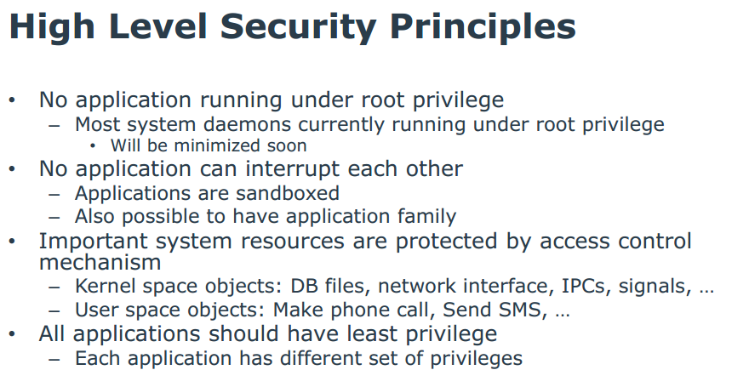
Tizen OS (Samsung) [Gad14]

Slide 25
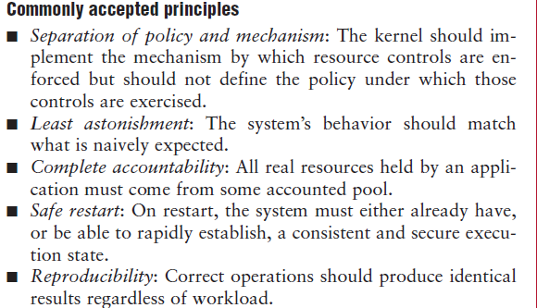
Principles used in the EROS OS [Sha02]

Slide 26
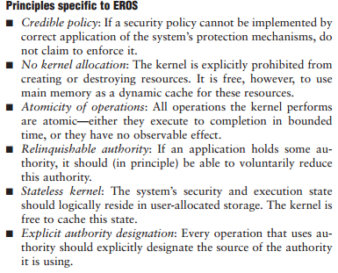

Slide 27
Kerkhoff’s principle (from the Wikipedia)
In cryptography, Kerckhoffs' principle (also called Kerckhoffs' desideratum, Kerckhoffs' assumption, axiom, doctrine or law) was stated by Dutch cryptographer Auguste Kerckhoffs in the 19th century: A cryptosystem should be secure even if everything about the system, except the key, is public knowledge.
Kerckhoffs' principle was reformulated (or perhaps independently formulated) by American mathematician Claude Shannon as "the enemy knows the system", i.e., "one ought to design systems under the assumption that the enemy will immediately gain full familiarity with them". In that form, it is called Shannon's maxim. In contrast to "security through obscurity", it is widely embraced by cryptographers.

Slide 28
Another principle
It is preferable to have a secure architecture with some insecure code that secure code with an insecure architecture
Reason: The first combination is easier to fix and it is harder to attack

Slide 29
Security models
Classification
Access matrix
Role-Based Access Control
Multilevel security

Slide 30
Models
Security models are a more precise and detailed expression of policies and are used as guidelines to build and evaluate systems. Usually they are described in formal or semi-formal way.
Models can be discretionary or mandatory. In a discretionary model, holders of rights can be allowed to transfer them at their discretion. In a mandatory model only designated roles are allowed to grant rights and users cannot transfer them
An orthogonal classification divides models into those based on the access matrix, Role-Based Access Control, and multilevel models. The first two of these models control access while the last one attempts to control information flow. Mandatory and discretionary models can be combined with the access matrix and the multilevel model.

Slide 31
Classification of authorization models
Multilevel --users and data are assigned security levels
Access matrix -- subject has specific type of access to data objects
Mandatory --access rules defined only by administrators
Discretionary -- users own data and can grant access to other users

Slide 33
Access matrix authorization rules
Basic rule ( s, o, t ) , where s is a subject (active entity), t is an access type, and o is an object
Extended rule ( s, o , t , p,f) , where p is a predicate (access condition or guard) and f is a copy flag
This, and the other models, can be described by OO patterns

Slide 34
Access Matrix
 | Database A | Component Q | Interface F
Alice | Read-Write; Always | Hire | Yes
Bob | Read-Write; Between 9 and 5 | Fire | No
Charles | No access | Modify salary | No
Dave | No access | AssignTo Unit | Yes
Eve | Read-only; Always | Evaluate | No

Slide 35
Administrative rights
transfer{t/t*} to M(s,o)---transfer can be destructive or not, depending on the policy.
grant{t/t*} to M(s,o)—in a grant both grantor and grantee have the right after the grant.
delete t from M(s,o)—a right is removed from a subject.
read M(s,o)—inspect the right of a subject for an object.
create object o
delete object o
create subject s
delete subject s

Slide 36
Authorization pattern

Slide 37
Authorization mapping

Slide 38
Role-Based Access Control
Users are assigned roles according to their functions and given the needed rights (access types for specific objects)
When users are assigned by administrators, this is a mandatory model
Can implement least privilege and separation of duty policies
Reduces number of rules

Slide 39
Basic RBAC pattern

Slide 40
Growing models
We can grow models by adding classes, e.g. from Authorization to RBAC we add a Role class.
We can add sessions as execution context
We can add hierarchies of roles and of objects (Composite pattern)
Subroles inherit role rights from superclass roles.
Access to an object gives implicit access to its subobjects

Slide 42
More extensions to RBAC
Separation of administrative roles: administrators have special rights to create users, roles, grant rights,…
Groups of users: a set of users taken as a whole for access rights
9/7/2018
42

Slide 43
Extended RBAC pattern

Slide 44
Role rights for financial institution
Customers can open/close accounts
Customers can initiate trade
Broker can perform trade
Auditor can inspect (read) trade transactions
9/7/2018
44

Slide 45
9/7/2018
45

Slide 46
Implied authorization
For convenience we may need to group or structure subjects, protection objects, and some access types in such a way that they may imply others in some ordering structure. In this case, a rule component may be implied by another rule and this must be taken into account when evaluating access.
The concept of implied authorization was introduced in [Fer75b] and subsequently has been applied in some research projects and used in the later versions of the Windows operating system (starting with NT Version 4.0) and the .NET component authorization. It has also been applied to object-oriented databases where access rights can be inherited along generalization or aggregation hierarchies as we discuss in the chapter on database systems.

Slide 47
Multilevel models
Because of the way they control security they have also been called data (information) flow models, they control the allowed flow of data between hierarchical levels. These models have been formalized in three different ways:
The Bell-La Padula model, intended to control leakage of information between levels.
The Biba model, which controls data integrity.
The Lattice model, which generalizes the partially ordered levels of the previous models using the concept of mathematical lattices.

Slide 48
Features of the multilevel models
Users and data are assigned classifications or clearances
They are mandatory models (users are assigned to classifications by administrators)
Classifications include levels (top secret, secret,…), and categories (compartments) (engDept, marketingDept, Army, …)
Typically use data labels (tags) to indicate their classifications or levels, used to enforce security
In each level an access matrix may further refine access control.
Need trusted processes to perform administrative functions (e.g., declassify documents, increase a user’s clearance) so secure flow of control is not violated

Slide 49
Categories and levels
Army
Navy
Air Force
Top Secret
Secret
Levels
Confidential
Classified

Slide 50
Bell-LaPadula rules (confidentiality)
Simple security (ss) property. A subject s may read object o only if its classification dominates the object’s classification, i.e., C(s) => C(o). This is the no read-up property.
*-Property. A subject s that can read object o is allowed to write object p only if the classification of p dominates the classification of o, i.e., C(p) => C(o). This is the no write-down property.
A security classification dominates another if and only if its level is greater or equal than the other level and its categories include the other categories. For example, in the next figure, level L1 dominates level L2. Security levels L1 and L3 or L2 and L3 are incomparable.

Slide 52
Example of Bell and LaPadula Model
O₅
high
(w)
(w)
S₂
O₄
(r)
(r)
O₃
(w)
(w)
S₁
O₂
(r)
(r)
low
O
S
O₁

Slide 53
The Biba integrity model
Biba’s model classifies the data into integrity levels and defines two properties dual to the simple security and * properties. This model includes the properties:
Single integrity property. Subject s can modify object o only if I(s) >= I(o).
Integrity *-property. If subject s has read access to object o with integrity level I(o), s can write object p only if I(o) >= I(p).
The first property establishes that an untrusted subject cannot write in objects of a higher level of integrity or she would degrade that object.
The * property protects information from flowing up the hierarchy

Slide 54
Biba Model (2)
BLP
BIBA
O₅
high
(w)
(r)
(w)
S₂
O₄
(r)
(r)
(w)
(w)
O₃
(w)
(r)
(r)
(w)
(w)
S₁
O₂
(r)
(r)
(w)
(w)
O₁
low
(r)

Slide 55
Multilevel security pattern (BellLaPadula)

Slide 56
Enforcement of authorization
Regardless of how we define authorization rules, we need to enforce them.
An abstract rule enforcer is a Reference Monitor (RM)
When an RM is implemented in a system it must include authentication information and authorization rules, we call this a Policy Enforcement Point (PEP)
The data needed for A&A is called Policy Definition Point (PDP)

Slide 57
Reference Monitor
Each request for resources must be intercepted and evaluated for authorized access
Abstract concept, implemented as memory access manager, file permission checks, CORBA adapters, etc.

Slide 58
Reference Monitor idea

Slide 59
Reference monitor pattern (basic idea)

Slide 60
Reference monitor (with reified Decision)

Slide 61
Enforcing access control

Slide 62
Where to apply the controls:
Account
Customer
TX
Authentication
Authentication
Authorization
Logging

Slide 63
Authentication, Authorization, and Logging
After a user is recognized as a legitimate user by the Authentication system she is admitted to the system.
For the user to access specific resources (memory, files, I/O devices) or data items she needs Authorization rights.
For every access (read or writes) to data, a Logging system records the data item accessed, the time, the type of access, and the user who performed the access.
The log can be audited later to check the proper use of the data.

Slide 64
9/7/2018
64

Slide 65
Financial example: Adding more security: authentication, logging, separation of duty
openAcct
closeAcct
Not as Acct
User Role
MRight
…
1
Manager
*
…
Account
*
*
Acct User Role
*
Transaction
*
*
log
1
1
Authenticator
Logger
1

Slide 66
Governance
Governance means establishing and enforcing how a group agrees to work together in co-ordination. Specifically, governance is the establishment of:
Chains of responsibility to assign duties and rights to people (role engineering)
Measurement to gauge effectiveness
Policies to guide the organization to meet its goals
Control mechanisms to ensure compliance with regulations and policies
Communication to keep all required parties informed
Governance determines what decisions are to be made, who should be making the decisions and what policies should be considered before making any decisions Management defines ways to apply specific aspects of governance to the control of cloud resources

Slide 67
Reference architectures
A Domain Model (DM) is a model of an area of knowledge, e.g. financial systems, and has no software concepts
A Reference Architecture (RA) is a generic architecture, valid for a particular domain, with no implementation aspects. It is reusable, extendable, and configurable
It is a kind of pattern for whole architectures and it can be instantiated into a specific software architecture by adding implementation-oriented aspects.

Slide 68
POSA template (Buschmann)
Intent (thumbnail)
Example
Context
Problem and forces
Solution: in words, UML models (static and dynamic)
Implementation
Example resolved
Known uses
Consequences
See also (related patterns)

Slide 69
Anatomy of a security pattern
Every pattern starts with a thumbnail of the problem it solves and a brief description of how it solves the problem.
The Packet Filter Firewall filters incoming and outgoing network traffic in a computer system based on packet inspection at the IP level.

Slide 70
Context section
We define the context or environment where the pattern solution is applicable:
Context
Computer systems on a local network connected to the Internet and to other networks with different levels of trust. A host in a local network receives and sends traffic to other networks. This traffic has several layers or levels. The most basic level is the IP level, made up of packets consisting of headers and bodies (payloads). The headers include the source and destination addresses as well as other routing information, the bodies include the message payloads.

Slide 71
Problem Section I
Now a generic description of what happens when we don’t have a good solution: We also indicate the forces that affect the possible solution. We may list all attacks that we want to stop with this solution.
Problem
Some of the hosts in other networks may try to attack the local network through their IP-level payloads. These payloads may include viruses or application-specific attacks. We need to identify and block those hosts.
:

Slide 72
Forces
We need to communicate with other networks so isolating our network is not an option. However, we do not want to take a high risk.
The protection mechanism should be able to reflect precisely the security policies of the institution. A too coarse defense may not be useful.
Any protection mechanism should be transparent to the users. Users should not need to perform special actions to be secure.
The cost and overhead of the protection mechanism should be relatively low or the system may become too expensive to run.
Network administrators deploy and configure a variety of protection mechanisms; hence it is important to have a clear model of what is being protected.
The attacks are constantly changing; hence it should be easy to make changes to the configuration of the protection mechanism.
It may be necessary to log input and/or output requests for auditing and defense purposes.

Slide 73
Solution section
The solution section describes the idea of the pattern. A descriptive figure may help to visualize the solution.
Solution
A Packet Filter Firewall intercepts all traffic coming/going from a port P and inspects its packets (Figure 1). Those coming from or going to untrusted addresses are rejected. The untrusted addresses are determined from a set of rules that implement the security policies of the institution. A client from another network can only access the Local Host if a rule exists authorizing traffic from its address. Rules may be positive (allow traffic from some address) or negative (block traffic). Additionally, if a request is not satisfied by any of the Explicit Rules, then a Default Rule is applied.

Slide 74
Idea of the solution

Slide 75
Structure of the solution

Slide 76
Filtering a client’s request

Slide 77
Implementation section
What one should consider when implementating the pattern is the objective of the next section. This can be a set of general recommendations or a sequence of what to do to use the pattern. It may include some sample code if appropriate.
Implementation
Define an institution policy about network access, classifying sites according to our trust in them.
Convert this policy into a set of access rules. This can be done manually, which may be complex for large systems. An alternative is using an appropriate commercial product. .
Note that the idea of a single point of access is virtual, there may be several physical firewalls deployed at different places. This means it is necessary to install firewalls at all external boundaries (routers or gateways).
Write the rules in each firewall. Again, products such as Solsoft and others automatically propagate the rules to each registered firewall.
Configure the corresponding firewalls according to standard architectures. A common deployment architecture is the Demilitarized Zone (DMZ) [Sch06].

Slide 78
Known uses section
To accept this solution as a pattern we should find at least three examples of its use in real systems.
Known Uses
This architecture can be found in commercial firewall products such as: ARGuE (Advanced Research Guard for Experimentation), OpenBSD Packet Filtering Firewall (the basic firewall architecture for the Berkeley Software Distribution system) and the Linux Firewall, the basic firewall architecture used with the Linux operating system.

Slide 79
Consequences--advantages
The Consequences section indicates the advantages and disadvantages of the solution embodied in this pattern. The advantages should match the forces in the Problem section.
Consequences
The Packet Filter Firewall Pattern has the following advantages:
A firewall transparently filters all the traffic that passes through it, thus lowering the risk of communicating with potentially hostile networks.
It is possible to express the institution filtering policies through its filtering rules, with different levels of protection for different parts of the network.
It is easy to update the rule set to counter new threats.
Because it intercepts all requests, a firewall allows systematic logging of incoming and outgoing messages. Because of this, a firewall facilitates the detection of possible attacks and helps to hold local users responsible of their actions when interacting with external networks.
Low cost, it is included as part of many operating systems and simple network devices such as routers.
Good performance. It only needs to look at the headers of IP packets, not at the complete packet.
It can be combined with Intrusion Detection Systems (IDS) for greater effectiveness. In this case, the IDS can tell the firewall to block suspicious traffic. This can also be useful to control Distributed Denial of Service (DDoS) attacks.

Slide 80
Consequences--disadvantages
The firewall’s effectiveness and speed may be limited due to its rule set (order of precedence). Addition of new rules may interfere with existing rules in the rule set; hence, a careful approach should be taken in adding and updating access rules.
The firewall can only enforce security policies on traffic that goes through the firewall. This means that one must make changes to the network to ensure that there are no other paths into its hosts.
An IP-level firewall cannot stop attacks coming through the higher levels of the network. For example, a hacker could put malicious commands or data in header data not used for routing and in the payload.
Each packet is analyzed independently, which means that it is necessary to analyze every packet. This may reduce performance.
A packet filter cannot recognize forged addresses (IP spoofing) because it only examines the header of the IP packet. This can be corrected (at some extra cost) using Link Layer filtering, where each IP address is correlated to its hardware address [Fra01].

Slide 81
Related patterns section (See also)
Finally, we relate our pattern to other known patterns. Those may be complementary patterns, variations of our pattern, or extensions of it.
The Authorization pattern [Fer01] defines the standard security model for the Packet Filter Firewall Pattern. This pattern is also a special case of the Single-Point-of-Access [Sch06] and it is the basis for other, more complex, types of firewalls (described in the other patterns in this language). The DMZ pattern [Sch06] defines a way to configure this pattern in a network. This pattern can also be combined with the Stateful Inspection Firewall [Sch06].

Slide 82
References on principles
[Gad14] Olga Gadyatskaya; Fabio Massacci; Yury Zhauniarovich, “Security in the Firefox OS and Tizen Mobile Platforms”, Computer, IEEE 2014, Volume: 47, Issue: 6 , 57 - 63, DOI: 10.1109/MC.2014.165
[Sal75] J. H. Saltzer and M. D. Schroeder, “The protection of information in computer systems”, Procs. of the IEEE, vol. 63, No 9, Sept.1975, 1278-1308.
[Sha02] Jonathan S. Shapiro, Norm Hardy, EROS: A Principle-Driven Operating System from the Ground Up, IEEE Software, Jan/Feb 2002, 26-33

Slide 83
References on pattern writing
Tim Wellhausen, Andreas Fießer, ” How to write a pattern? A rough guide for first-time pattern authors”,
http://europlop.net/sites/default/files/files/0_How%20to%20write%20a%20pattern-2011-11-30_linked.pdf
Neil Harrison, “Advanced Pattern Writing: Patterns for Experienced Pattern Authors”, http://europlop.net/sites/default/files/files/1_2003_Harrison_AdvancedPatternWriting.pdf

